Slide 1

Combining Human and Machine Intelligence to Describe Images to People with Visual Impairments
Meredith Ringel Morris
Microsoft Research

Slide 2
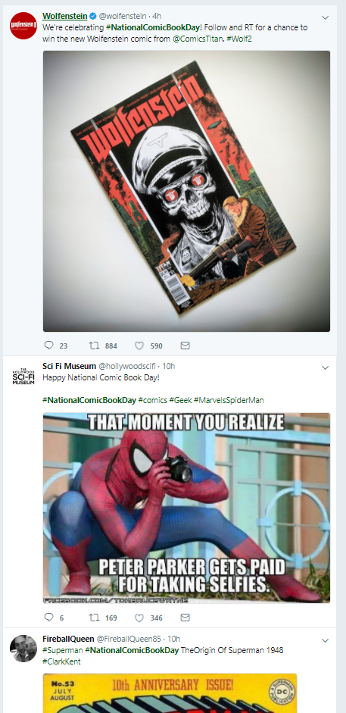
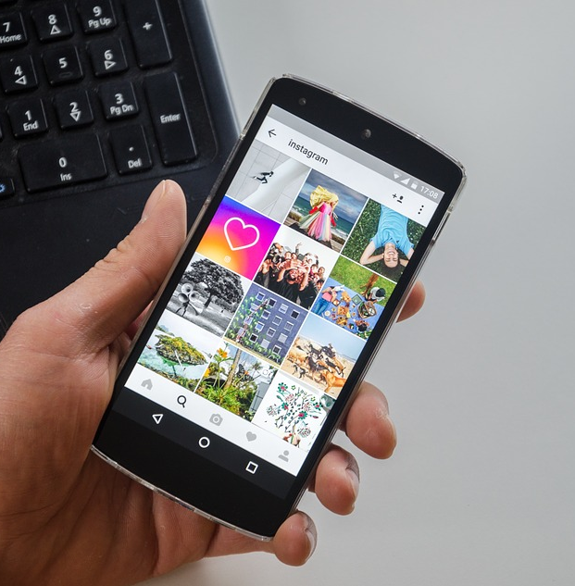
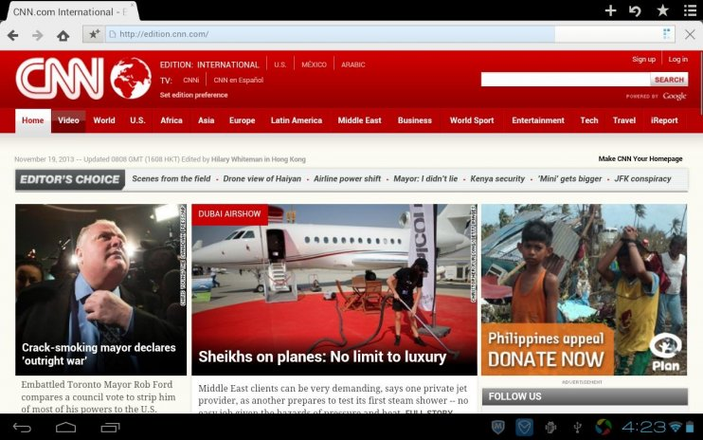
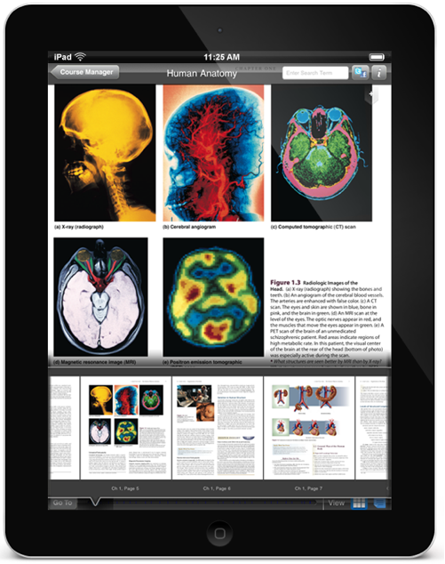
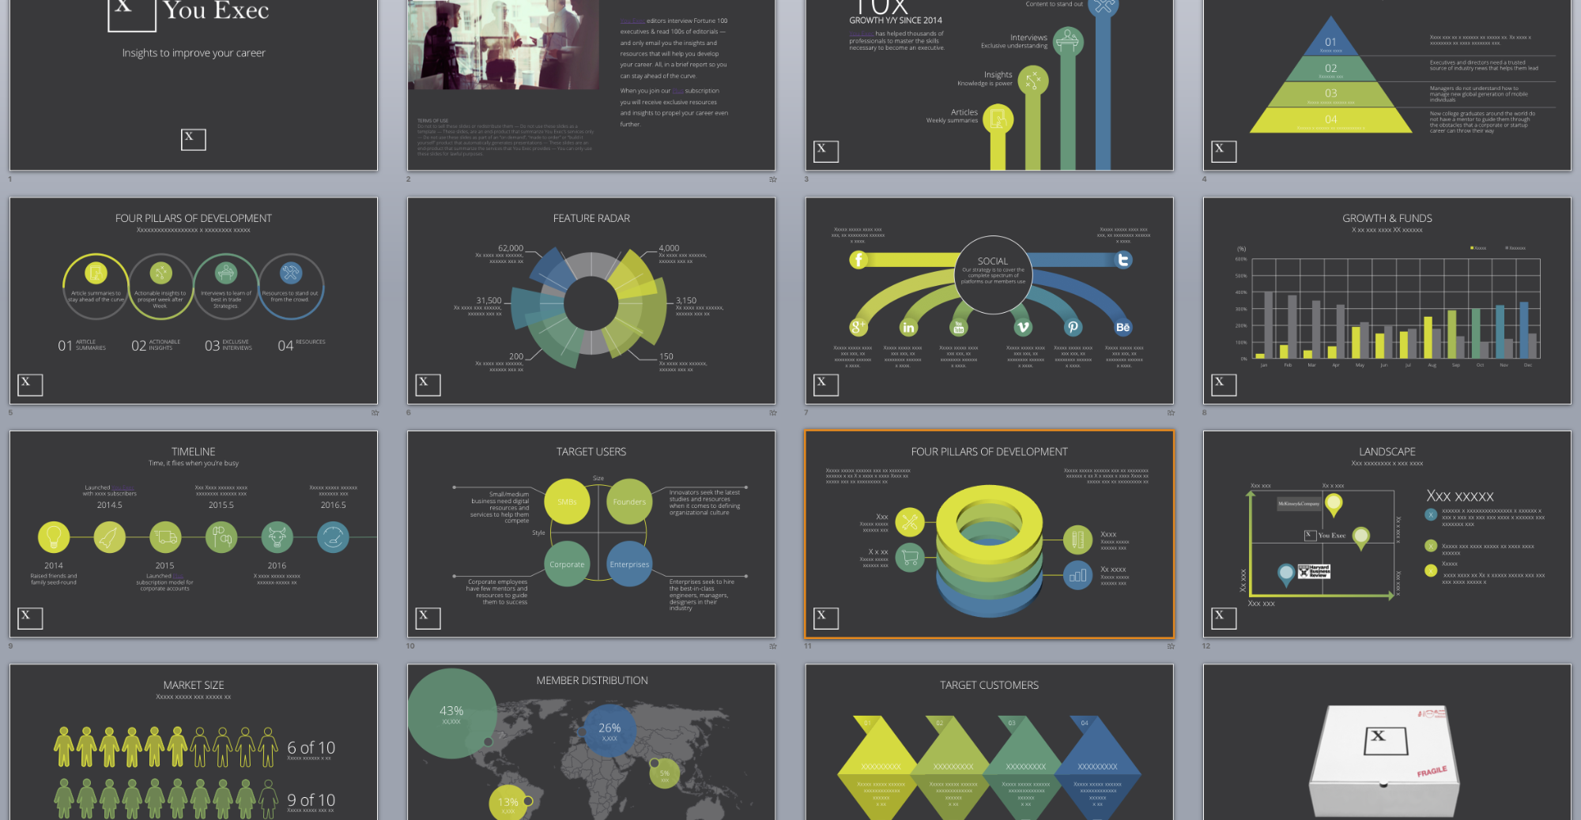

Slide 3
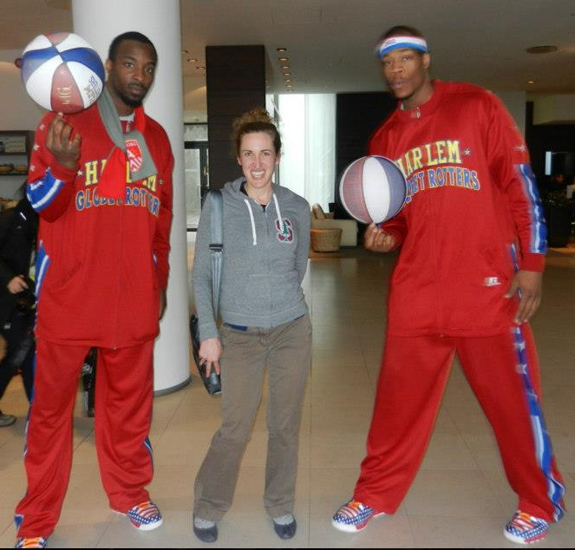
<img src=“iceland2013.jpg” alt=“a short researcher stands between two very tall members of the Harlem Globetrotters basketball team”>

Slide 4

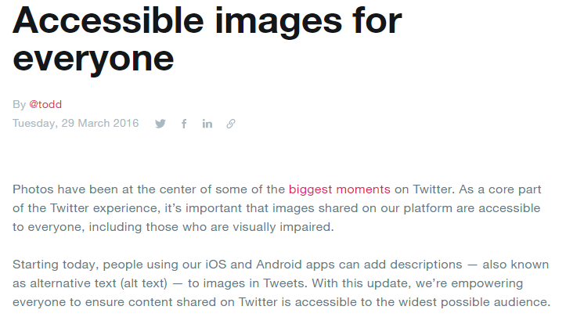
<img src=“iceland2013.jpg”>
<img src=“iceland2013.jpg” alt=“image”>
<img src=“iceland2013.jpg” alt=“iceland2013.jpg”>

Slide 5
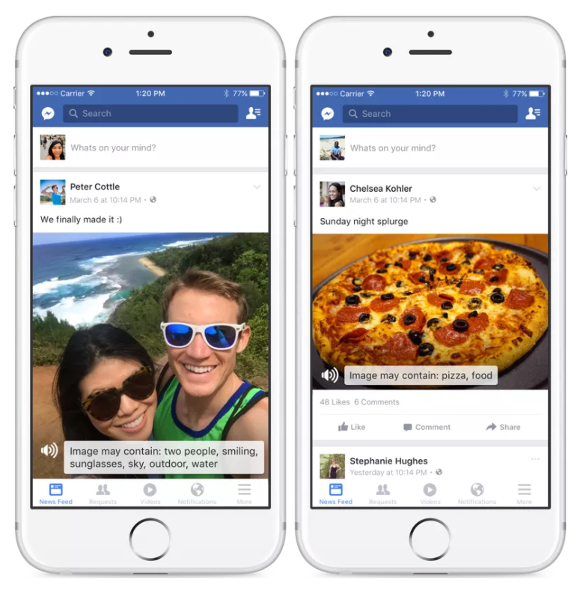
Facebook’s Automatic Alt Text

Slide 6
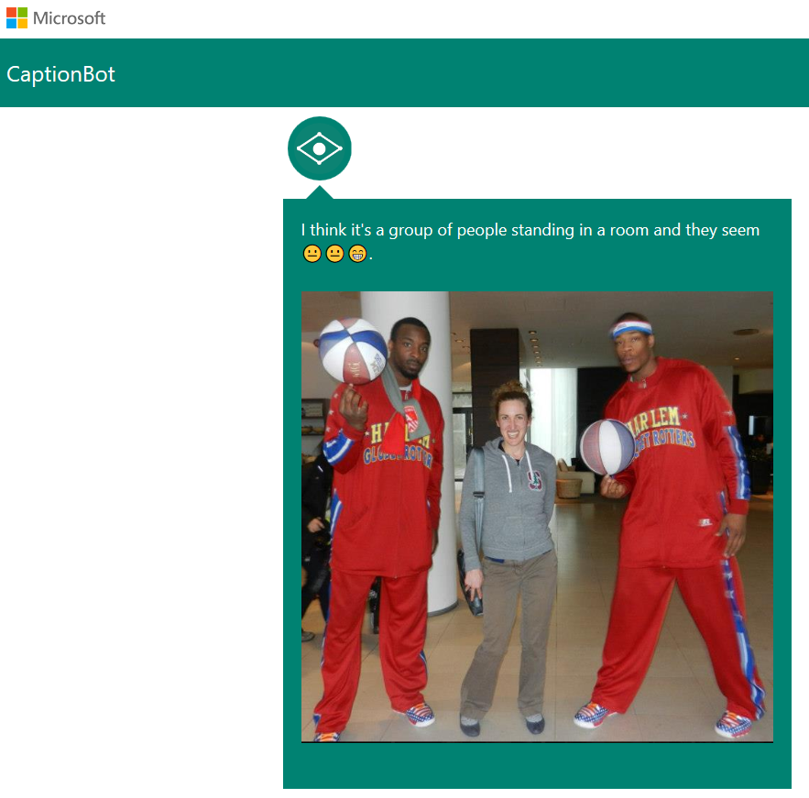
MSR’s captionbot.ai

Slide 7


Understanding Blind People’s Experiences with Captions of Social Media Images [MacLeod et al., CHI 2017]
Contextual Inquiry
Experiences with image captions
in the Twitter feed (n=6)
Online Experiment
The impact of caption phrasing
on trust and skepticism (n=100)

Slide 8
Study One:
Contextual
Inquiry

Slide 9
Tweet/Image Probes:
Taken from trending hashtags, popular accounts
Range of topics (news, memes, photography, cats, selfies, etc.)
Computer generated captions as alt text

Slide 10
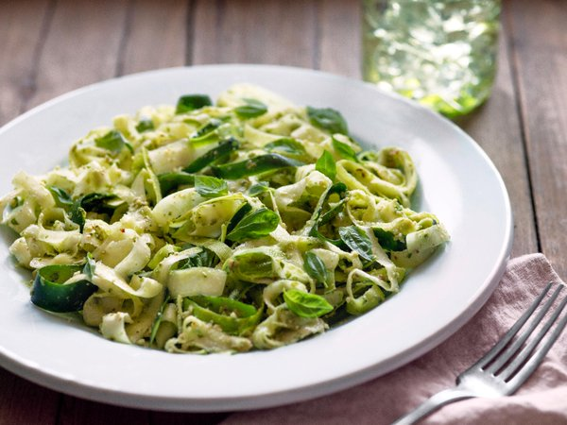
@WholeFoodsMarket Ready for #summer entertaining? Plan w/ special diets in mind. #glutenfree #paleo #vegan
“I think it’s a plate of pasta and broccoli”

Slide 11
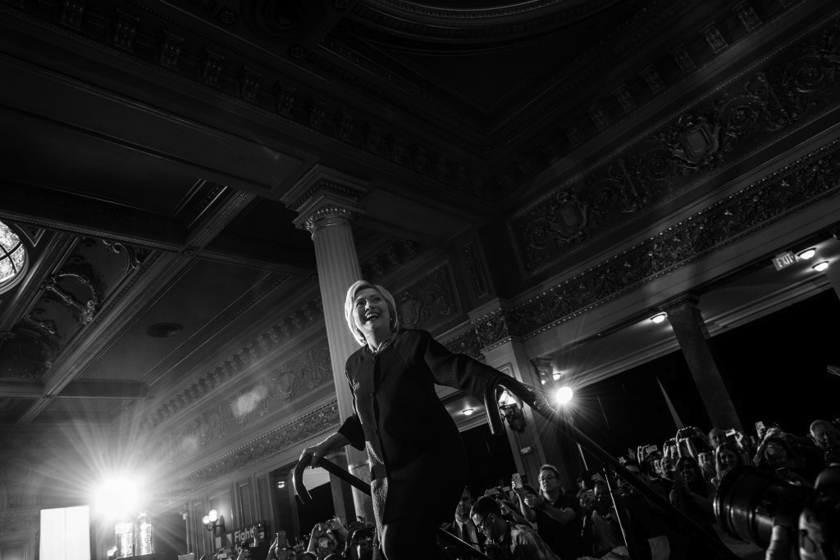
@HillaryClinton Some on the other side may say our best days are behind us. Let's prove them wrong.
“I’m not really confident, but I think
it’s a man doing a trick on a skateboard at night.”

Slide 12
“If you say, there’s an older man on a skateboard at night that would make more sense. That’s the way I take ‘our best days are
behind us’ because I’m an old lady…” (P3)

Slide 13
“I probably would have just retweeted it thinking it was a photo of a skateboarder” (P3)

Slide 14
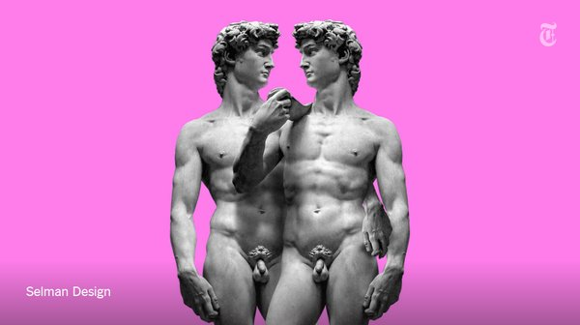
@NewYorkTimes Why isn’t Italy kinder to gays?
I'm not really confident, but I think it's a person
holding a tennis racquet and she seems neutral face.

Slide 15
“Okay, so it’s a tennis player.
Who, if I recognized tennis players, maybe she’s gay.” (P2)

Slide 16
“Why is a tennis racket involved in this story? The way pictures are eye catching to people, it would engage a different side
of my perception. Saying, oh tennis racket.
I don’t play tennis, but maybe that’s
even more interesting than I thought.” (P5)

Slide 17
“I have to trust them because
I don’t have any form of reference […]
Unless somebody sighted were saying,
‘I don’t know why they said that,
that’s not what it is at all…’” (P1)

Slide 18
“I felt pretty confident about
them being accurate” (P2)

Slide 19
Study Two:
Online Experiment

Slide 20
Framing Effects
X% chance of dying
vs.
Y% chance of surviving

Slide 21
Framing Effects
X% chance of dying
vs.
a very small chance of dying

Slide 22
 | Positive Framing | Negative Framing
Natural Language Framing | “I'm really confident that's a cat sitting on a counter next to a window.” | “There's a small chance I could be wrong, but I think that's a cat sitting on a counter next to a window.”
Numeric Framing | “There's an 80% chance that's a cat sitting on a counter next to a window.” | “There's a 20% chance I'm wrong, but I think that's a cat sitting on a counter next to a window”

Slide 23
Congruent Captions
vs.
Incongruent Captions

Slide 24
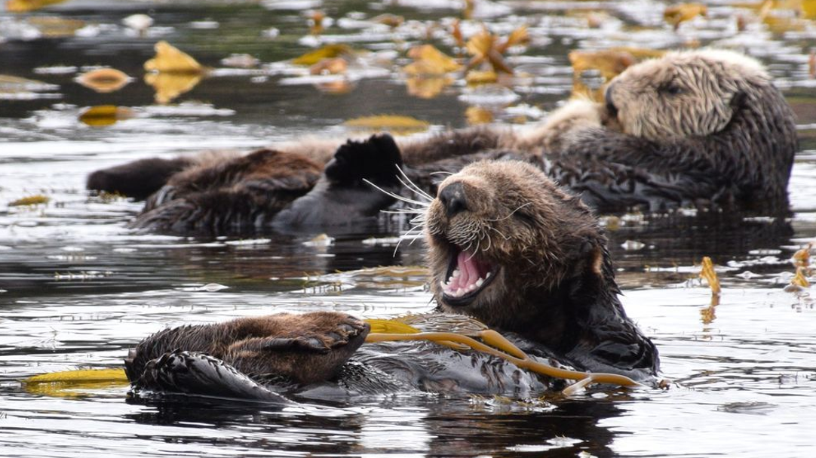
@ALensOnAmerica Share your best wildlife photo from a national park and get feedback from @chamiltonjames. #YourShot.
“There's a 25% chance that's a bear is swimming in the water.”

Slide 25
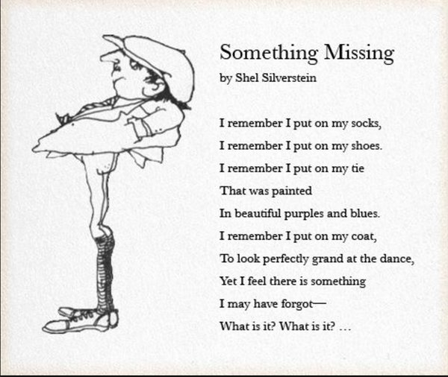
@SeattlePoliceDepartment Bank robber arrested after abandoning pants.
“There’s a 5% chance that’s a person on a surfboard in a skatepark.”

Slide 26
People found tweets with high congruence
to be more trustworthy and more helpful.
People who received negatively framed captions trusted incongruent captions significantly less often.

Slide 27
Thus, we recommend that
automatically generated captions
be phrased in a way that reinforces
the possibility the caption might be wrong (negative framing).

Slide 28
Negatively framed captions help
blind and visually impaired people
rely more on their intuition about a caption,
rather than unquestioningly trusting a caption and making decisions based off misinformation.

Slide 29
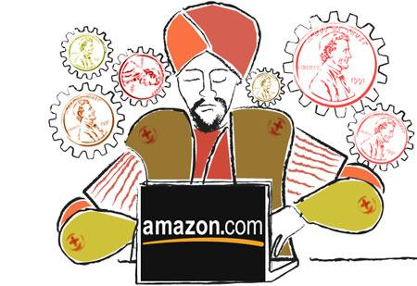


Human Computation
Crowdsourcing
Friendsourcing
Free
High saturation [Pew 2012]
Personalized and trusted [Morris 2010]
Matches existing model [Kane 2009, Burton 2012]
Low-cost
Always-available workers
Anonymous

Slide 30
Human Computation for Image Labeling: VizWiz [Bigham et al., 2010] VizWiz Social [Brady et al., 2013]

Slide 31
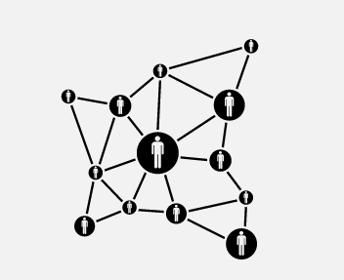

Crowdsourcing
Friendsourcing
Costs money✗
Extremely fast ✓
Workers are strangers ✗
No social costs ✓
✓ Free
✗ Answers may be slow
✓ Friends are trusted
✗ May bother friends

Slide 32
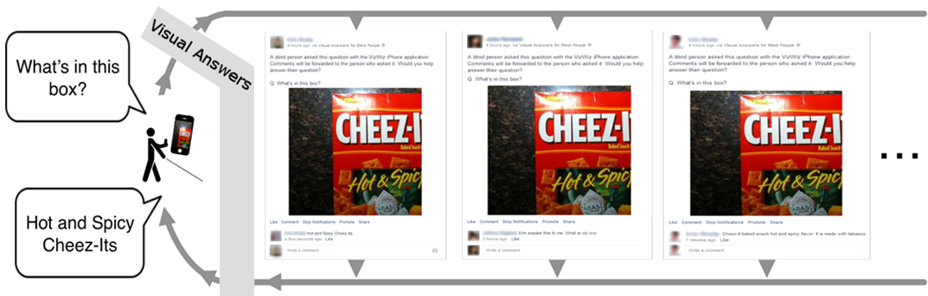
Social Microvolunteering [Brady et al., CHI 2015]

Slide 33


Social Microvolunteering
Crowdsourcing
Friendsourcing
Slacktivism

Slide 34

“Slacktivism” and Volunteering
Low-effort activism mediated by technology
Some view it as a way to avoid real impact
Can draw awareness and lead to future actions
Voida, A. et al. CHI 2012; Vie, S. First Monday 2014; Lee, Y.-hao and Hsieh, G. CHI 2013.

Slide 35
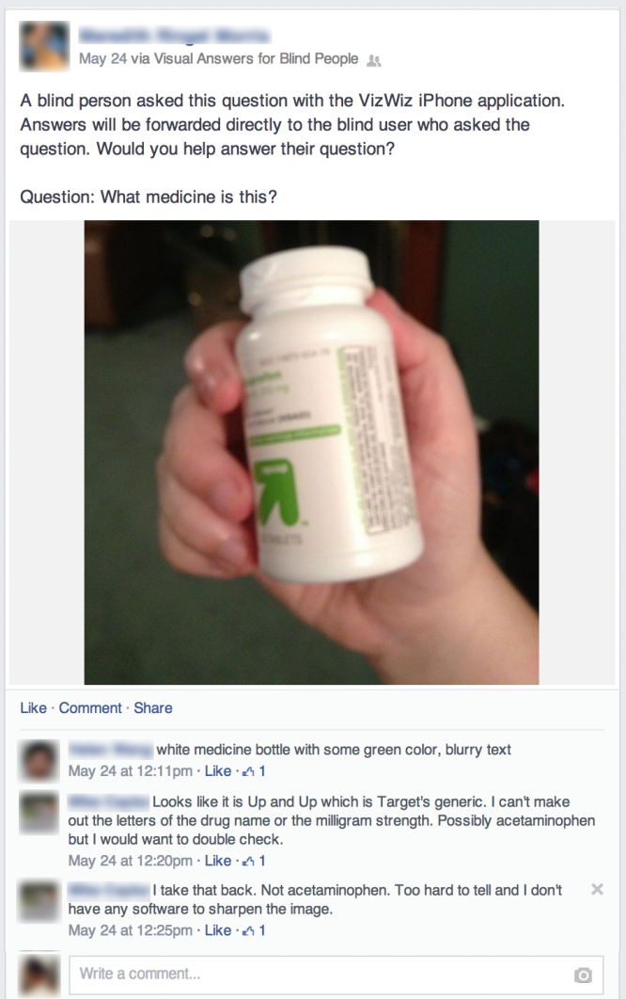

Slide 36
Visual Answers Pilot
Pilot study with 91 volunteers
Compensated half of them with $20 for participating
64% had friends, family members with disability
Questions pre-selected from VizWiz archives
Visual Answers posted 1,130 questions
42% of questions received at least 1 comment
756 total comments (avg. 1.6 per answered post)
Examined response speed, quality, and feedback

Slide 37
Response Speed
First comment average 50 minutes
Posted to 20 walls, first response in 156 seconds
66 seconds if question is easy to answer

Slide 38
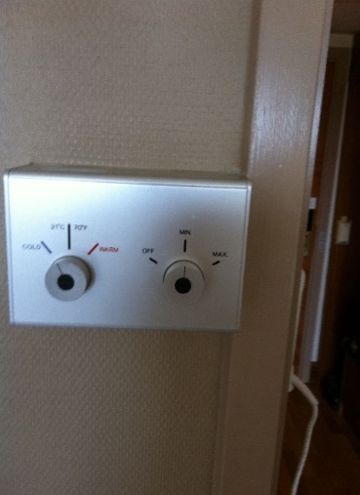
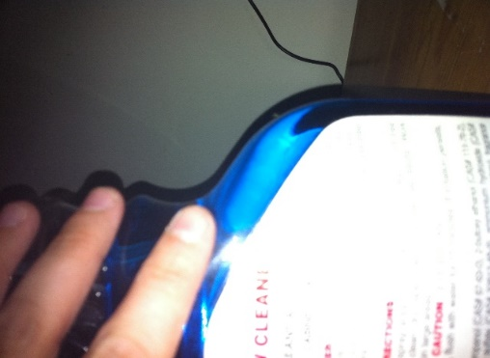
Answer Quality
“Good faith” answers
Correct answer if question is answerable
Explanation, feedback on how to retake if unanswerable
[“Which knob, is it the left or the right, is for temperature control?”] Left one is for Temperature. It has three settings cold to the left, 21 Celsius/70 Farenheit in the center and warm to the right.
[“What does this bottle say?”] The flash on the camera seems to have caused the label to be too bright white to read. Also; the picture is not centered to see the full product. My guess is that it is window/glass cleaner.

Slide 39
Volunteer Responses
95% felt positive about their use of Visual Answers
83% said that they would want to use Facebook for social microvolunteering in the future

Slide 40
With social microvolunteering, we can get free, fast, and anonymous work for tasks with an altruistic component.
Crowdsourcing
Friendsourcing
Slacktivism

Slide 41
Conversational Crowdsourcing as a Tool for Refining Vision-to-Language Technology [Salisbury et al., HCOMP 2017]
RQ1: What value is provided by a state-of-the-art vision-to-language API in assisting BVI users, and what are the areas for improvement?
RQ2: What are the trade-offs between alternative workflows for the crowd assisting BVI users?
RQ3: Can human-in-the-loop workflows result in reusable content that can be shared with other BVI users?

Slide 42
Image Description Workflows
Workflow 1 = Vision-to-Language [captionbot.ai; Fang et al., CVPR 2015]
Workflow 2 = Human-Corrected Captions
Workflow 3 = TweetTalk conversational assistant
Workflow 4 = Structured Q&A

Slide 43
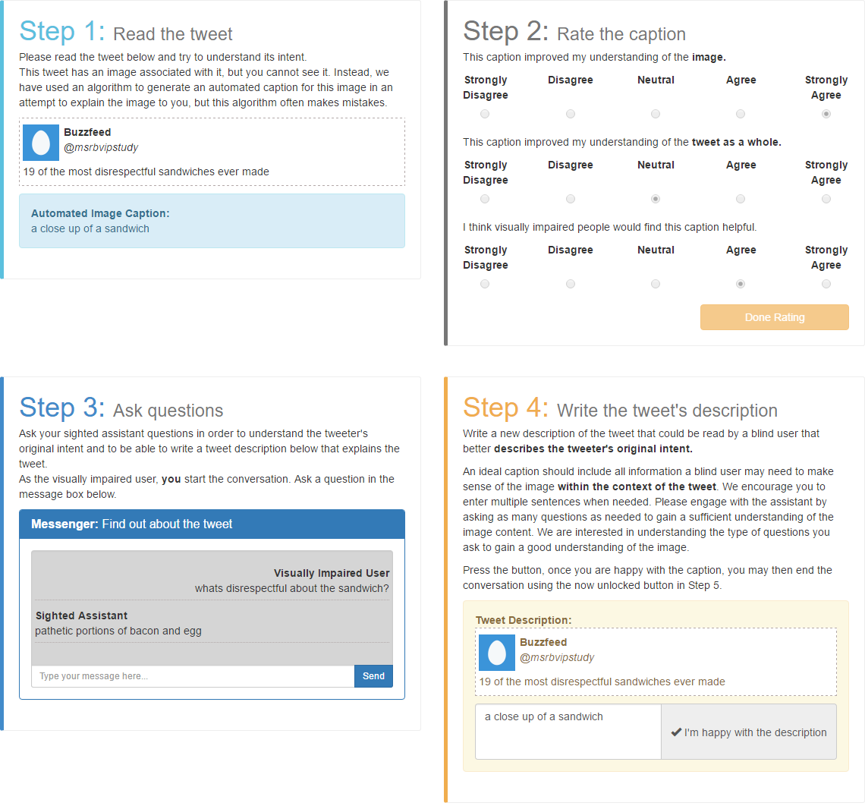
TweetTalk

Slide 44
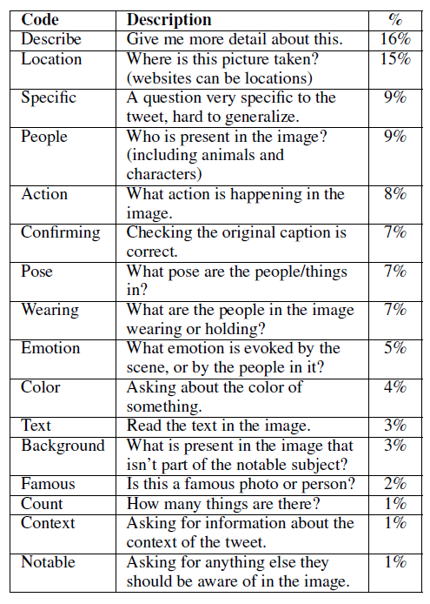

Slide 45
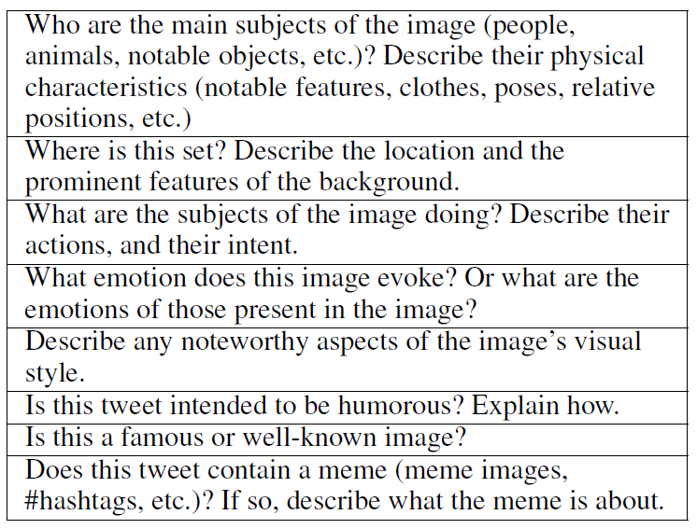
Structured Questions

Slide 46
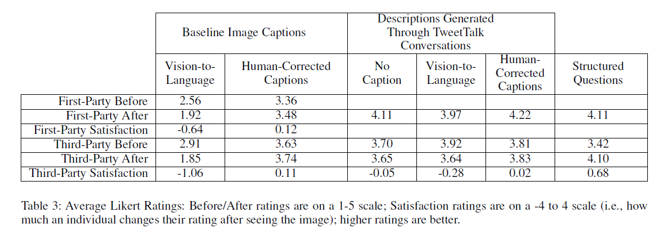

Slide 47
Reflection
Level of description desired by a user may vary based on interest in the tweet, time pressure, VI onset
Bad automatic caption was worse than no caption!
Need for AI systems to create and convey user-understandable quality and confidence metrics
Our SQs covered subjective details (e.g., context, emotion) not handled well by current AI systems
9% of questions were highly specific to the tweet (“Can I only buy tickets with an AmEx card?”) and may require conversational assistants
Personalized captions? (FB vs. twitter?)
SQA for content author templates? Interactive alt text?

Slide 48
Summary
Billions of digital images lack captions for people who are VI
Automated systems have promise, but aren’t yet ready for prime time
Improve accuracy
Improve level and types of detail
Clearly express uncertainty to the user clearly
Crowd-powered methods have promise, but won’t scale to billions
Financial and social costs; quality, privacy, and self-presentation issues
Hybrid approaches (corrections, conversations, question templates) can target high-value images, while providing data to train automated systems for scaling

Slide 49
Thank you to my collaborators:
Cindy Bennett (UW)
Jeff Bigham (CMU)
Erin Brady (IUPUI)
Ed Cutrell (MSR)
Ece Kamar (MSR)
Haley MacLeod (Indiana U.)
Elliot Salisbury (U. of Southampton)

Slide 50
Questions?
merrie@microsoft.com, @merrierm, merrie.info
References:
aka.ms/crowdaccess [Zyskowski et al., CSCW 2015]
aka.ms/tweetaccess [Morris et al., CHI 2016]
aka.ms/microvolunteering [Brady et al., CHI 2015]
aka.ms/captiontrust [MacLeod et al., CHI 2017]
aka.ms/hcompalttext [Salisbury et al., HCOMP 2017]
aka.ms/eyesfreeart [Rector et al., IMWUT 2017]

